Slide 1
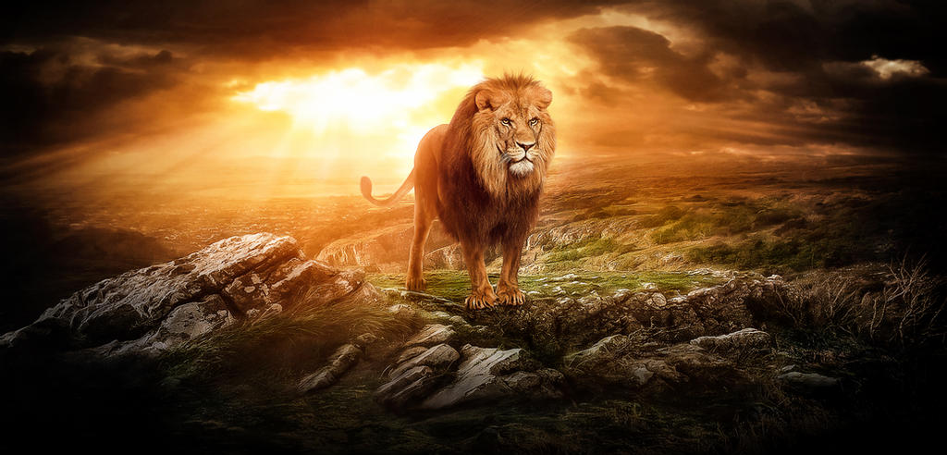

2021
ESCHATOLOGY
SERIES
WEEKLY MESSAGE

Slide 2

THANK’S
FOR JOINING US
TODAY
CHRIST | CULTURE | CREATOR

Slide 3
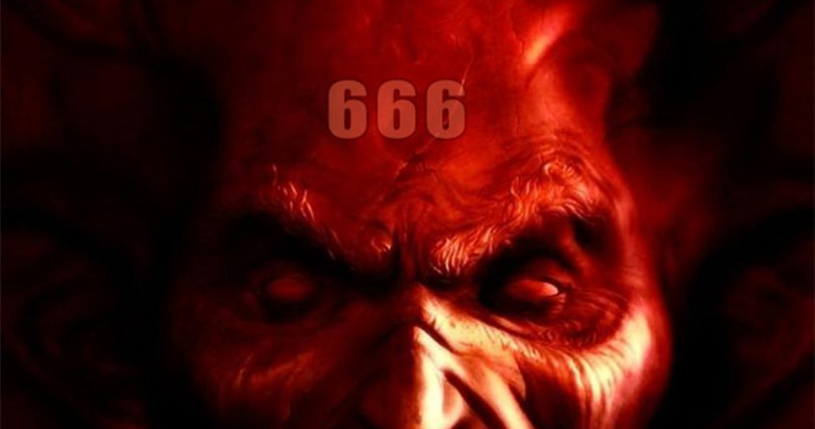
ESCHATOLOGY
2021
SERIES
#66
DEALING WITH THE DEVIL

Slide 4
TODAY’S PASSAGE Revelation 20: 1-6
Then I saw an angel coming down from heaven, holding the key of the abyss and a great chain in his hand. And he laid hold of the dragon, the serpent of old, who is the devil and Satan, and bound him for a thousand years; and he threw him into the abyss, and shut it and sealed it over him, so that he would not deceive the nations any longer, until the thousand years were completed; after these things he must be released for a short time. Then I saw thrones, and they sat on them, and judgment was given to them. And I saw the souls of those who had been beheaded because of their testimony of Jesus and because of the word of God, and those who had not worshiped the beast or his image, and had not received the mark on their forehead and on their hand; and they came to life and reigned with Christ for a thousand years. The rest of the dead did not come to life until the thousand years were completed. This is the first resurrection. Blessed and holy is the one who has a part in the first resurrection; over these the second death has no power, but they will be priests of God and of Christ and will reign with Him for a thousand years.”
2021 Eschatology Series Here

Slide 5
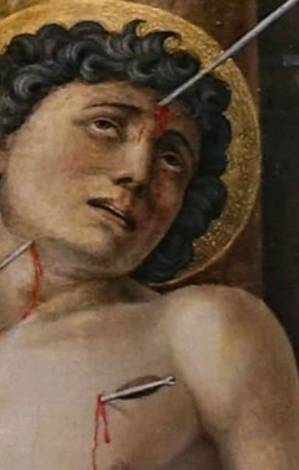
FEAR NOT MY CHILD
CHRISTIANS BOUND BY FEAR
“ ‘And Jesus answered and said to them (his disciples), “See to it that no one misleads you” (Matt. 24:4, parentheses added).
“ ‘For many will come in My name, saying, “I am the Christ,” and will mislead many’ ’’ (Matt. 24:5).
“ ‘You will be hearing of wars and rumors of wars. See that you are not frightened, for those things must take place, but that is not yet the end’ ” (Matt. 24:6).
Learn More
2021
Preparing for Hebrew 2023

Slide 6

SUDUCERS OF
THE CHURCH
Christ reveals that seducers are more dangerous enemies to the Church than persecutors. In this discourse, He mentions the appearance of false prophets three times.
The appearance of these seducers was the occasion of dividing the people into parties and factions, which made their ruin the easier and speedier, and the sin of the many that were led aside by them helped to fill the measure. Secondly, it was a trial to the disciples of Christ, and therefore agreeable to their state of probation (trial), that they which are perfect, may be made manifest.

Slide 7

APOSTTASY
MUST COME
Most conservative Christians are annoyed by other “Christians” who are liberal in their thinking--not believing the Word to be literal. In the end-times, many Bridal members will view the Word of God to be primarily “cultural”--not literal and absolute. Christ warned us of these times. By the way, we are in those times right now. This period of Christianity is called the Apostasy--there will, first, come a falling away. We may not be in the middle of the Great Apostasy, but we certainly are entering the warm-up phase.

Slide 8

SOVERNTY
OF AFFLICTIONS
Our afflictions are in God's hands. They are intended for the trial and improvement of our walk-in Christ. The only way to remove the impurities in raw gold is to purify it by fire. So, it is with the Christians; we, too, must be baptized by fire. It is a part of our commitment to the Groom.

Slide 9

SATAN
BOUND
It is time for Satan to get bound by the chains of Heaven. These aren’t chains as you and I are used to seeing or hearing about – these chains will have the power of God in them. That means that no matter how powerful the devil thinks he is, he will not break loose of this hold. Either Satan is stupid, or he is missing a few gears in his gear box. Even after Christ coming and destroying his system/empire by burning it to the ground, tosses his Beast and False Prophet into the lake of fire by one spoken Word and wiping out his entire army in less than an hour – how does this being think he can resist the hand of God? I think the depravity of Satan is far more deceptive than my human mind can behold. An old friend said to me once sin makes us stupid. Well, if Satan is SIN, he really must be stupid – this chapter proves that. In any case, the story unfolds.

Slide 10
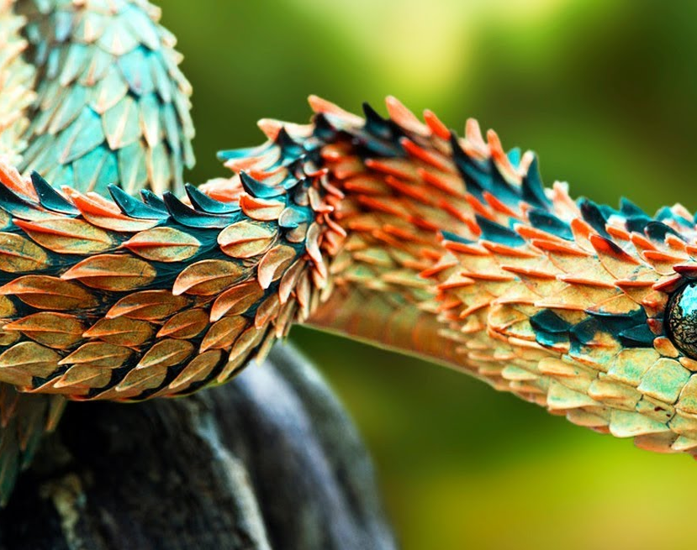
PEACE
There can be no Millennium, not a time of real peace, as long as Satan is on the loose. We know without question that he (Satan) is the god of the entire world, as it was during this confrontation. As the Lord calls him, the prince of power of the air is walking around on the earth like a raring lion hungry enough to eat or destroy everything in his path, with the deception that he can devour Christ Jesus as well. The key to remember here is that he has disguised himself as a minister of righteousness and, of course, an angel of light.

Slide 11
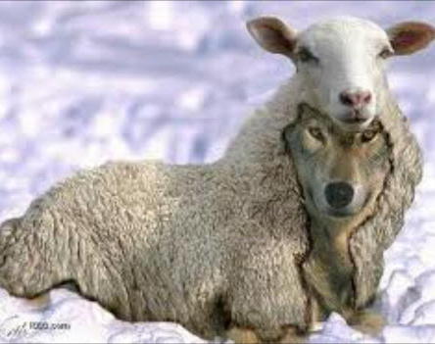
IN CONCLUSION
As crazy as it sounds, Satan will offer the same junk he offered Adam and Eve in the garden – to be like him. In his last desperate attempt to overthrow God’s throne, which is now being represented in the core of the new temple (remembering we just went through the thousand-year reign).

Slide 12
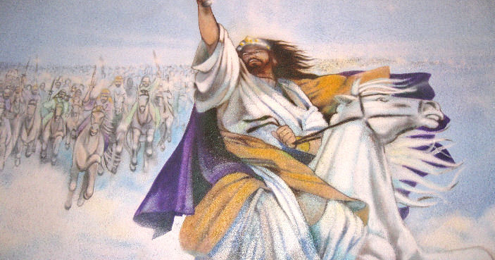
#67
2021
COMING UP NEXT
THE MILLENNIUM OF CHRIST

Slide 13
Consider Donating Here
THANK’S
FOR JOINING US
CHRIST | CULTURE | CREATOR
Email The Teacher | drphinney@iomamerica.org

